Slide 1


Background
Adaptive Markets
Steve Kunath, Kevin McCabe, Alex Psurek, Sarah Sylvester,
George Mason University
kmccabe@gmu.edu

Slide 2
The Exchange Process
Institutions act on the environment to produce outcomes
Connections
Promises
&
Contracts
The Environment
Production
&
Property Transfers
Goodwill &
Side Payments &
Judgments
Resources
- What
Technologies
- How
People
- Who
Matching
Negotiation
Fulfillment
Resolution
Continue Relationship ?

Slide 3
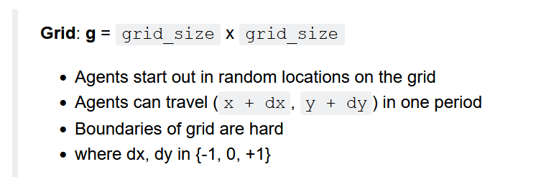
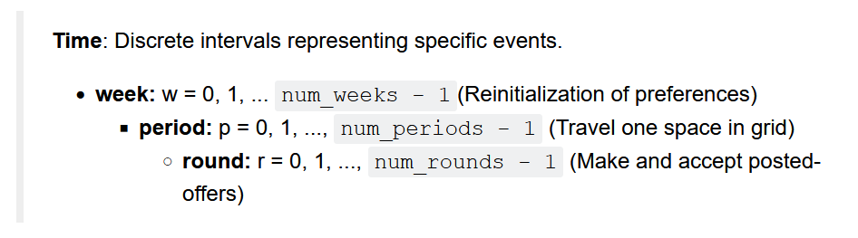
Our Model (Environment)
Gode and Sunder ZI – BC; Axtell and Epstein – Sugarscape

Slide 4
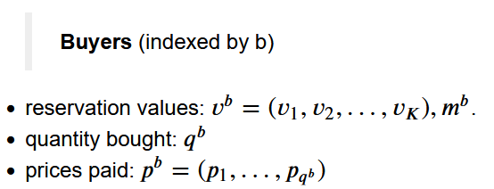

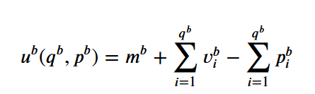

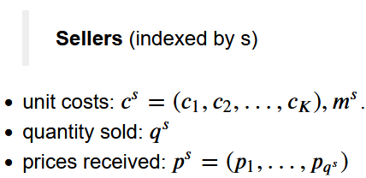



Our Model (Agents)

Slide 5
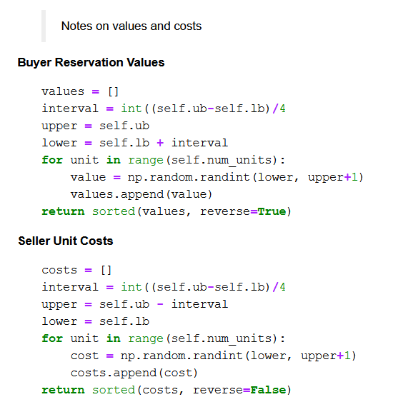

Slide 6
Our Model (Institutions in Blue)
Trial Loop: trial
agent_list = make_agents(…)
Week Loop: week
set cur_unit = 0 for all agents.
Period Loop: period
Travel Institution -> grid
for agent in agent_list:
`request_move` -> ‘move’ (dx, dy)
Grid Loop; grid_point
If buyer and seller at grid point:
Bargain Institution -> contracts
for agent in agent_list:
`request_offer` -> bid/ask makes order_book
For agent in shuffled(agent_list):
‘request_decision’ -> buy/sell makes contract

Slide 7
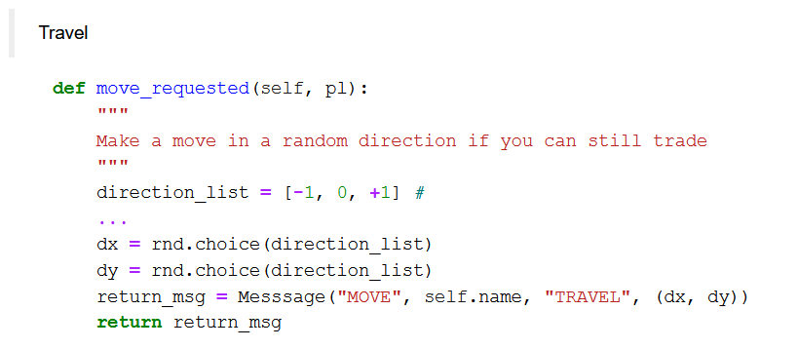
ZID Budget Constrained Strategy

Slide 8
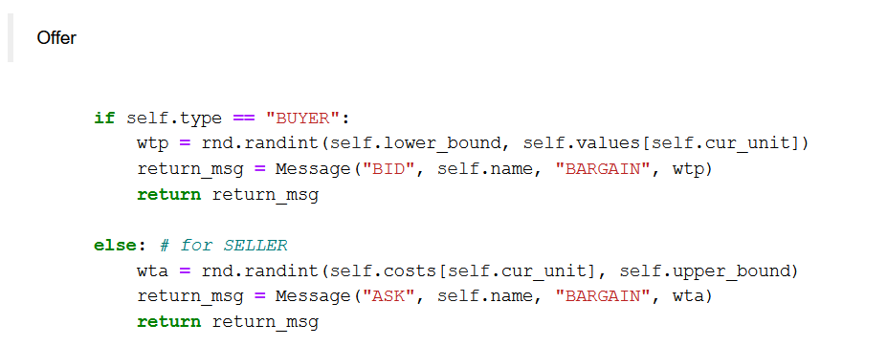
ZID Budget Constrained Strategy (continued)

Slide 9
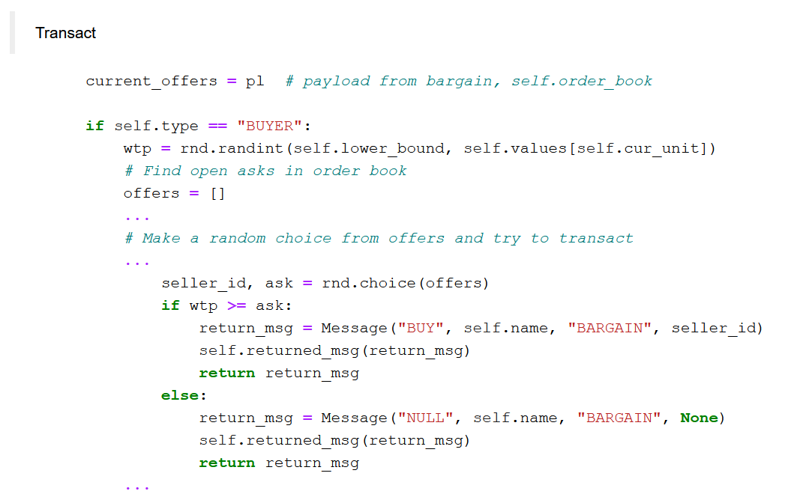
ZID Budget Constrained Strategy (continued)

Slide 10
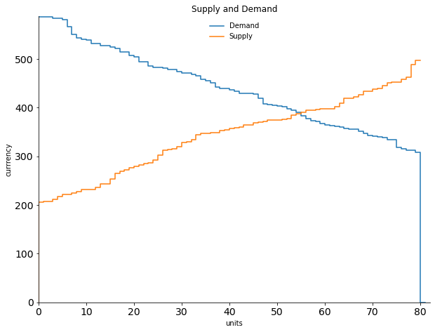
One Period ZID Simulation
equilibrium price = 388 - 391
equilibrium quantity = 55
maximum surplus = 9887
Example Period Simulation
grid_size = 1
num_rounds = 10
num_traders = 20
num_units = 8
lower_bound = 200
upper_bound = 600

Slide 11
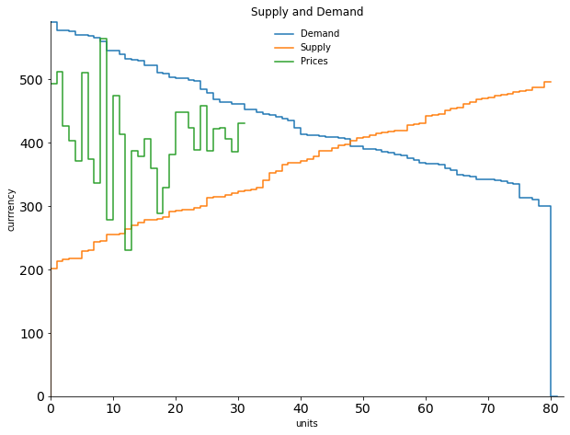
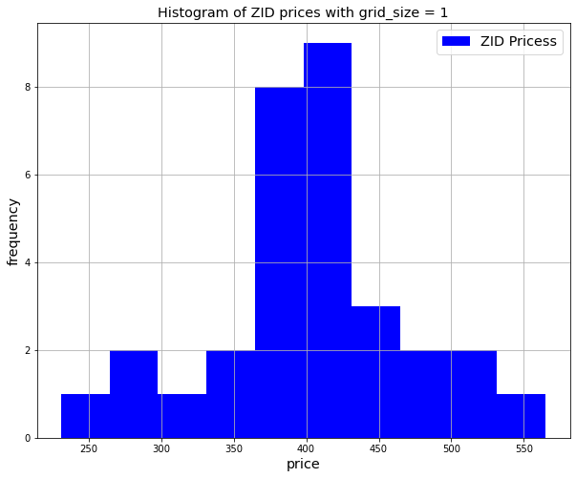
equilibrium price range is 398 to 403
average price = 404.84
eq expected contracts = 48, actual contracts = 31 actual surplus = 7283 , maximum surplus = 8890
efficiency = 81.92%.
One Period ZID Simulation Results

Slide 12
Comparing Agent Strategies
ZID(TRADER):
MOVE -> (dx, dy) where dx ~ {-1, 0, +1}, and dy ~ {-1, 0, +1}
BID, ASK -> uniform random budget constrained offer
BUY, SELL -> uniform random budget constrained willingness to accept
-> uniform random choice of offer
ZIDP(ZID):
BUY, SELL -> uniform random budget constrained willingness to accept
-> picks best remaining offer

Slide 13
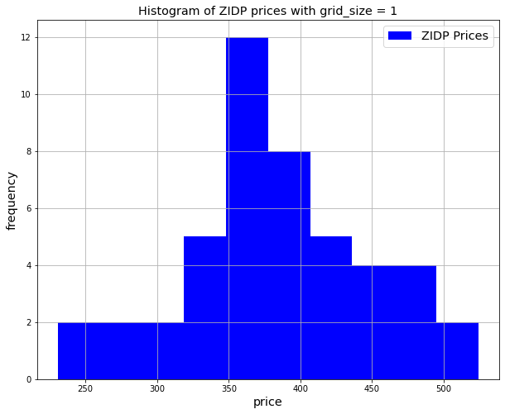
One Period Simulation
equilibrium price range is 398 to 403
average price = 404.84
eq expected contracts = 48, actual contracts = 31
actual surplus = 7283 , maximum surplus = 8890
efficiency = 81.92%.
equilibrium price range is 388 to 391
average price = 383.46
eq expected contracts = 55, actual contracts = 46
actual surplus = 9387 , maximum surplus = 9887
efficiency = 94.94%.

Slide 14
Simulations

Slide 15
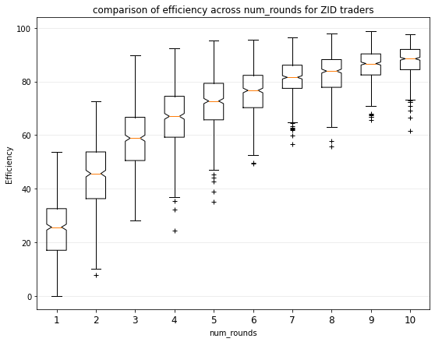
Efficiency increases with number of rounds
of bargaining
'num_weeks': 1,
'num_periods': 1,
'num_rounds': [1, 2, 3, 4, 5, 6, 7, 8, 9, 10],
'grid_size': 1,
'num_traders': 10,
'num_units': 6,
'lower_bound': 200,
'upper_bound': 600,
'num_trials': 500

Slide 16
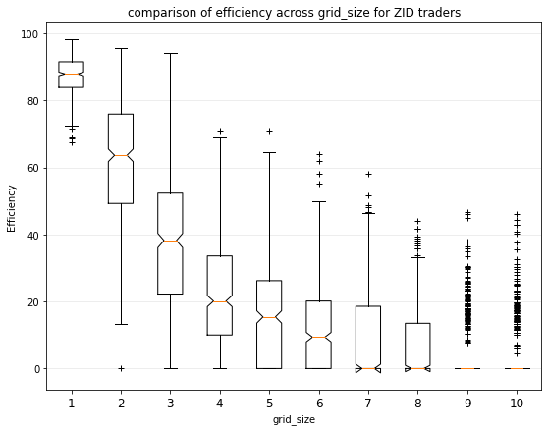
Efficiency decreases as gird size increases.
Note, num_periods = 1 means move only once.
'num_weeks': 1,
'num_periods': 1,
'num_rounds': 10,
'grid_size': [1, 2, 3, 4, 5, 6, 7, 8, 9, 10],
'num_traders': 10,
'num_units': 6,
'lower_bound': 200,
'upper_bound': 600,
'num_trials': 500

Slide 17
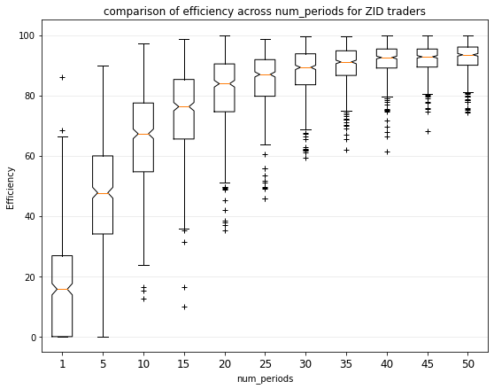
Efficiency increases as num_periods increases.
Note, more search for partners.
'num_weeks': 1,
'num_periods': [1, 5, 10, 15, 20, 25, 30, 35, 40, 45, 50],
'num_rounds': 10,
'grid_size': 5,
'num_traders': 10,
'num_units': 6,
'lower_bound': 200,
'upper_bound': 600,
'num_trials': 500

Slide 18
Comparing Agent Strategies
ZID(TRADER):
MOVE -> (dx, dy) where dx ~ {-1, 0, +1}, and dy ~ {-1, 0, +1}
BID, ASK -> uniform random budget constrained offer
BUY, SELL -> uniform random budget constrained willingness to accept
-> uniform random choice of offer
ZIDA(ZID):
MOVE -> if contract at period -> don’t move at period + 1; (dx, dy) = (0, 0)
-> otherwise, (dx, dy) where dx ~ {-1, 0, +1}, and dy ~ {-1, 0, +1}

Slide 19
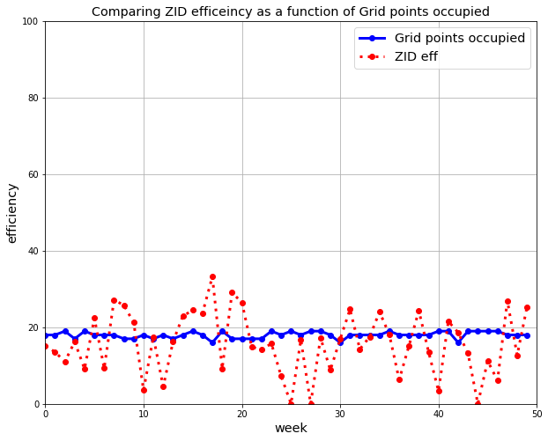
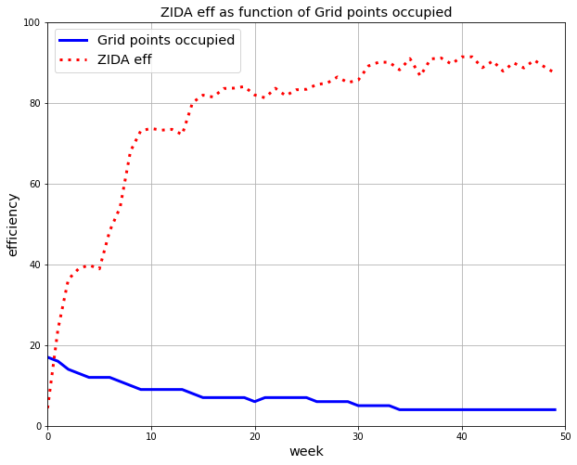
ZID and ZIDA strategies vs Number of grid points occupied
num_periods = 7
num_weeks = 50
num_rounds = 5
grid_size = 15
num_traders = 20
num_units = 8
lower_bound = 200
upper_bound = 600
Note local max
Number of agents at grid points occupied = [3, 6, 7, 4]

Slide 20
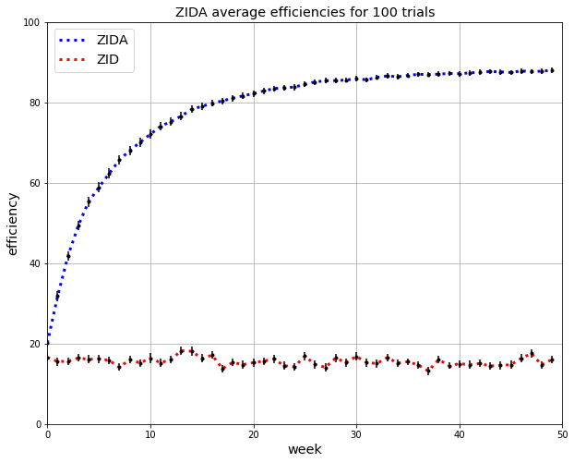
Compare efficiency of ZID, ZIDA
num_trials = 100
num_periods = 7
num_weeks = 50
num_rounds = 5
grid_size = 15
num_traders = 20
num_units = 8
lower_bound = 200
upper_bound = 600

Slide 21
Comparing Agent Strategies
ZID(TRADER):
MOVE -> (dx, dy) where dx ~ {-1, 0, +1}, and dy ~ {-1, 0, +1}
BID, ASK -> uniform random budget constrained offer
BUY, SELL -> uniform random budget constrained willingness to accept
-> uniform random choice of offer
ZIDP(ZID):
BUY, SELL -> uniform random budget constrained willingness to accept
-> picks best remaining offer

Slide 22
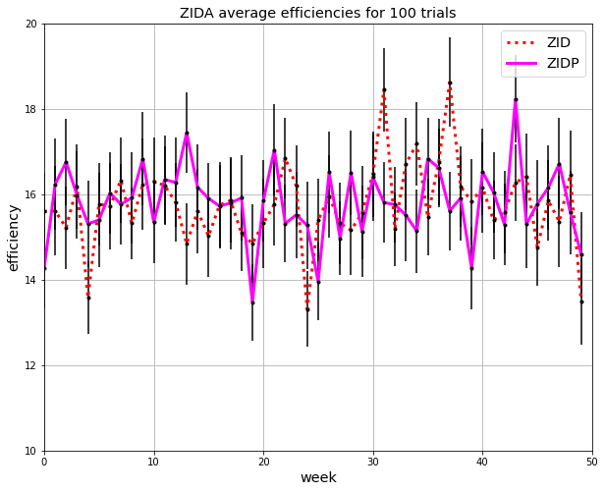
Compare efficiency of ZID, ZIDP
Note Narrow range on y-axis of graph
num_trials = 100
num_periods = 7
num_weeks = 50
num_rounds = 5
num_traders = 20
num_units = 8
lower_bound = 200
upper_bound = 600
grid_size = 15

Slide 23
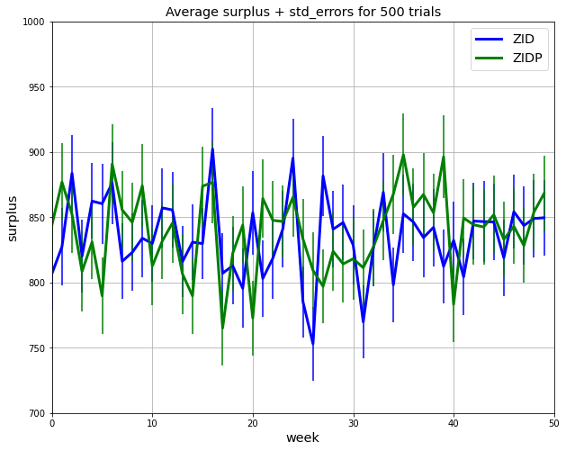
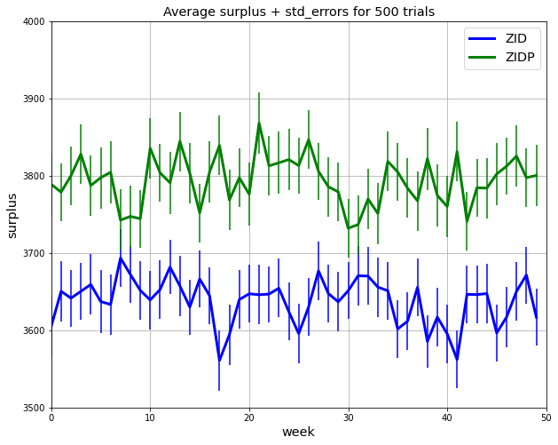
Compare surplus generation of ZID, ZIDP
Note Narrow range on y-axis of graph
num_trials = 500
num_periods = 7
num_weeks = 50
num_rounds = 5
num_traders = 20
num_units = 8
lower_bound = 200
upper_bound = 600
grid_size = 15
grid_size = 5

Slide 24
Comparing Agent Strategies
ZID(TRADER):
MOVE -> (dx, dy) where dx ~ {-1, 0, +1}, and dy ~ {-1, 0, +1}
BID, ASK -> uniform random budget constrained offer
BUY, SELL -> uniform random budget constrained willingness to accept
-> uniform random choice of offer
ZIDP(ZID):
BUY, SELL -> uniform random budget constrained willingness to accept
-> picks best remaining offer
ZIDA(ZID):
MOVE -> if contract at point -> don’t move (dx, dy) = (0, 0)
-> otherwise, (dx, dy) where dx ~ {-1, 0, +1}, and dy ~ {-1, 0, +1}
ZIDPA(ZIDP, ZIDA)

Slide 25
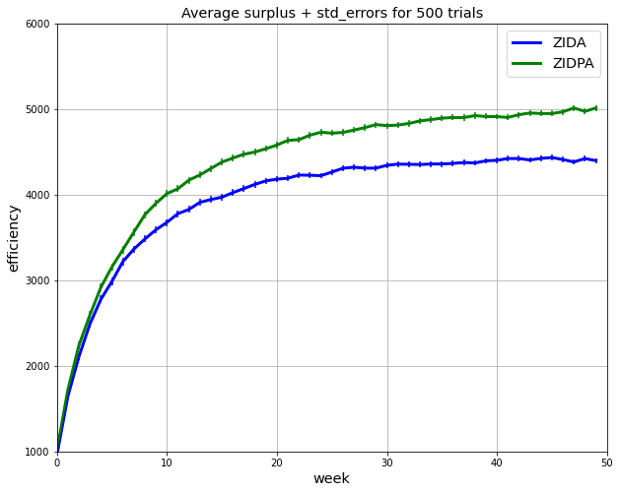
Compare Surplus 50% ZIDA, and 50% ZIDPA
num_trials = 500
num_periods = 7
num_weeks = 50
num_rounds = 5
grid_size = 15
num_traders = 20
num_units = 8
lower_bound = 200
upper_bound = 600

Slide 26
Comparing Agent Strategies
ZIDP(ZID):
BUY, SELL -> uniform random budget constrained willingness to accept
-> picks best remaining offer
ZIDPR(ZIDP):
MOVE
-> if num_agents at point > 2:
(dx, dy) where dx ~ {-1, +1} and dy ~ {-1, +1}
-> else:
if contract last period:
(dx, dy) = (0, 0):
else:
(dx, dy) where dx ~ {-1, 0, +1}, and dy ~ {-1, 0, +1}

Slide 27
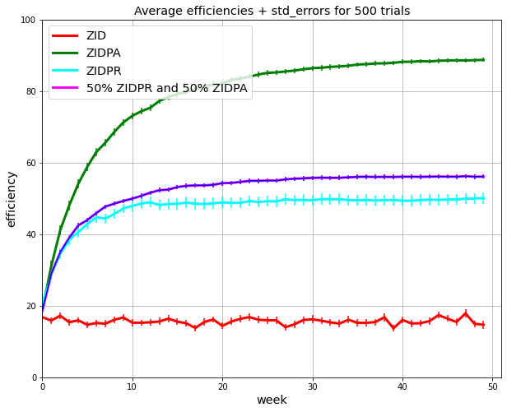
Compare Efficiency at 50% ZIDPA, and 50% ZIDPR
num_trials = 500
num_periods = 7
num_weeks = 50
num_rounds = 5
grid_size = 15
num_traders = 20
num_units = 8
lower_bound = 200
upper_bound = 600

Slide 28
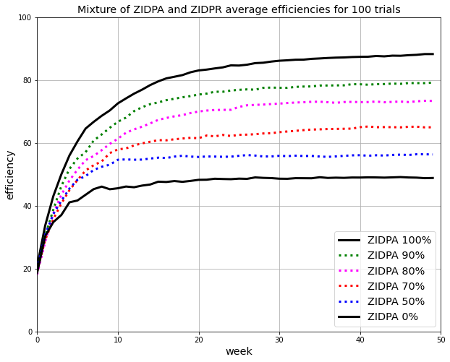
ZIDA 100%
ZIDA 90%
ZIDA 80%
ZIDA 70%
Compare Efficiency at %ZIDA, and %ZIDPR
ZIDA 50%
ZIDA 0%
num_trials = 100
num_periods = 7
num_weeks = 50
num_rounds = 5
grid_size = 15
num_traders = 20
num_units = 8
lower_bound = 200
upper_bound = 600

Slide 29
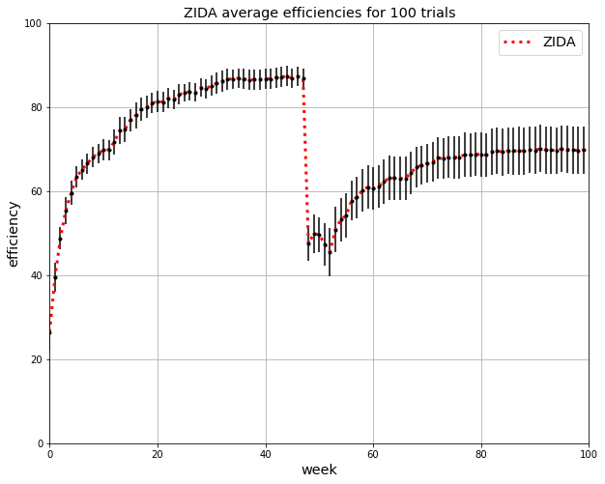
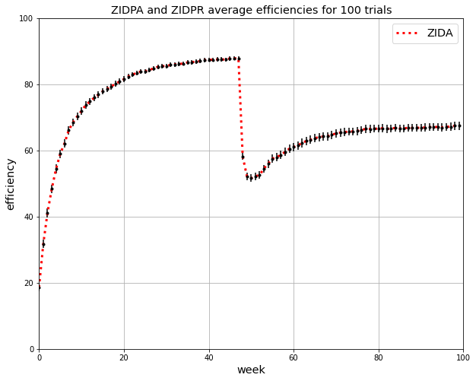
Compare surplus generation of ZID, ZIDP
Note Narrow range on y-axis of graph
num_trials = 100
begin event = 48
end event = 52
num_periods = 7
num_weeks = 50
num_rounds = 5
num_traders = 20
num_units = 8
lower_bound = 200
upper_bound = 600
100% ZIDPR during event
30% ZIDPR during event

Slide 30
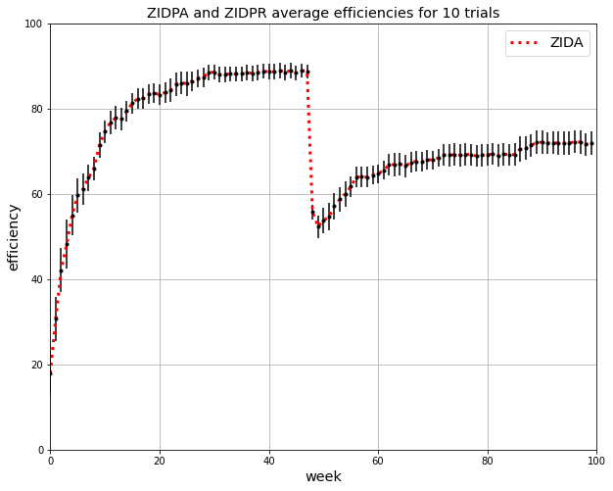
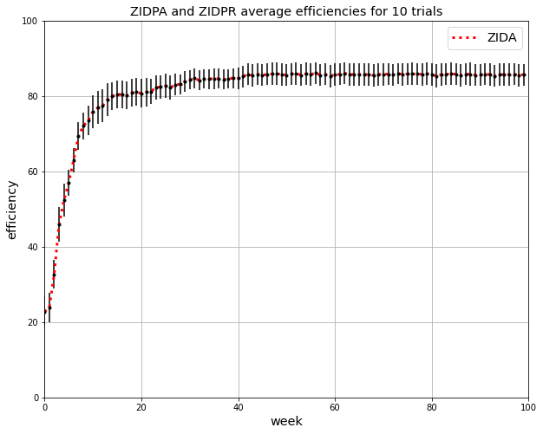

Slide 31
Thank You

Slide 32
Results
MES – On a spatial grid with order-book bargaining (First Two Stages)
ZID – Random Mover: Does not do well on spatial grid.
ZIDA – Stays when it contracts: Does much better than ZID spatial grid.
ZIDP – Takes best offer in order-book: Better (eff, rent-seeking) than ZID in small grids
ZIDPA – Combines ZIDA and ZIDP: Not more efficient than ZIDA, but better rent seeker
ZIDR – Avoids crowds > 2; does much worse (eff, rent-seeking) than ZIDA
ZIDPR – ZIDR & ZIDP – Same Results for eff and rent-seeking
- Pulls down eff disproportionately when combined with ZIDPR

Slide 33
Trial Loop: trial
agent_list = make_agents(…)
set random location for all agents
Week Loop: week
set cur_unit = 0 for all agents.
Period Loop: period
Travel Institution -> grid
for agent in agent_list:
`request_move` -> ‘move’ (dx, dy)
Grid Loop: grid_point
If buyer and seller at grid point:
Round Loop: round
Bargain Institution -> contracts
for agent in agent_list:
`request_offer` -> bid or ask; makes order_book
For agent in shuffled(agent_list):
‘request_decision’ -> buy or sell; makes contract

